Slide 1
DATA VISUALIZATION
MERGE_DATA
PRESENTED BY
K.NEERAJA

Slide 2
INTRODUCTION:-
Here we are going to see how the sales ,profit based on various categories such as Sales_Rep,Region,Customer_Code,year etc.
According to Sales_Rep what are the max_sales ,like wise according to region ,year .
Each category wise we should analyse and show the visualization report clearly in POWERBI.

Slide 3
DATA KEY VARIABLES:-
Date
Sales_Rep
Customer_Code
Sales
Profit
Region

Slide 4
EXPLAINATION:-
Here I took stacked column chart because here we can compare multiple categories and also show how category is divided in subcategories.
My data set is “MERGE_DATA”.
This dataset consists of Date,Customer_code,Region,Sales_Rep,Sales and Profit.
We are comparing every element with Sales and we can visualize how the sales are going according to sales_Rep what are the sales,According to Region what are the Sales and profit going to change.
Like wise we can clearly visualize the sales and report.

Slide 5
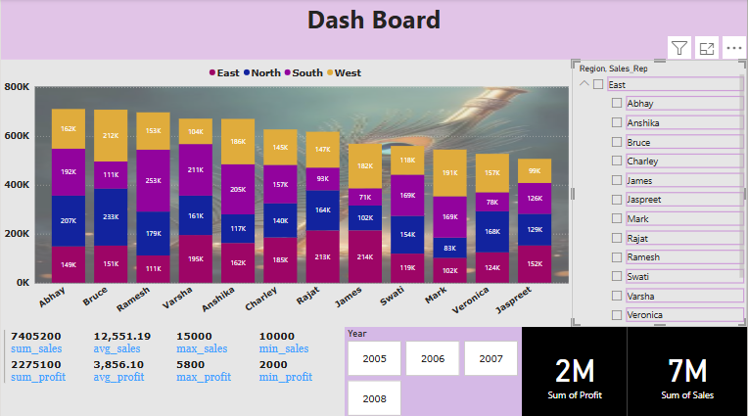
VISUALIZATION AND REPORT:-

Slide 6
CONCLUTION:-
From this data set I conclude that sales and profit changes according to region and sales_rep
We can visualize each and every element based on sales and profit.
Understanding about merge_data how it increases and decreases according to sales.

Slide 7


